Slide 1
Introduction to Reinforcement Learning

Slide 2
Agenda
Introduction
A brief History of AI
AI, ML, DL, RL and Big Data
Introduction to RL
RL achievement
How does it work ?
Actor – Critic model
RL Challenge

Slide 3
A BRIEF HISTORY OF AI

Slide 4
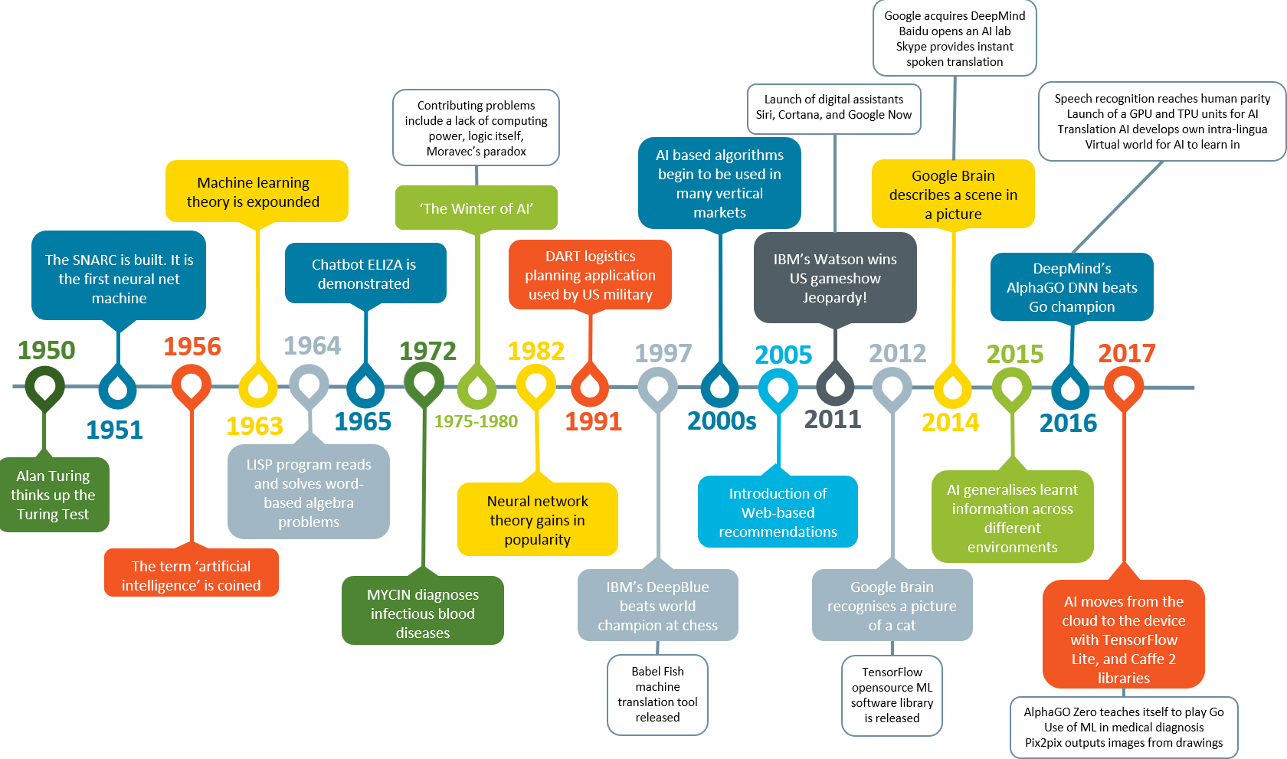

Slide 5
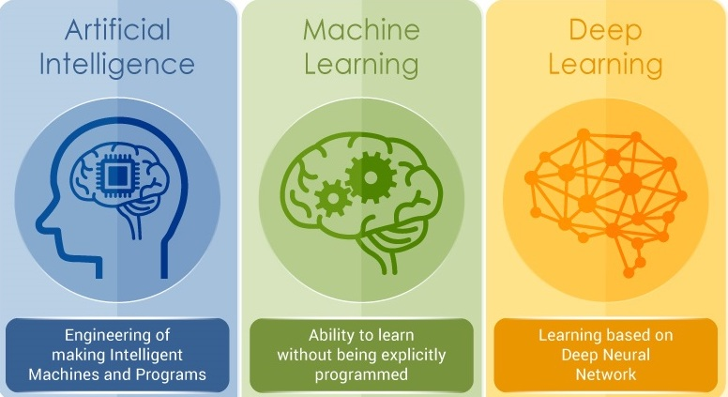
AI, ML, DL, RL and Big Data

Slide 6
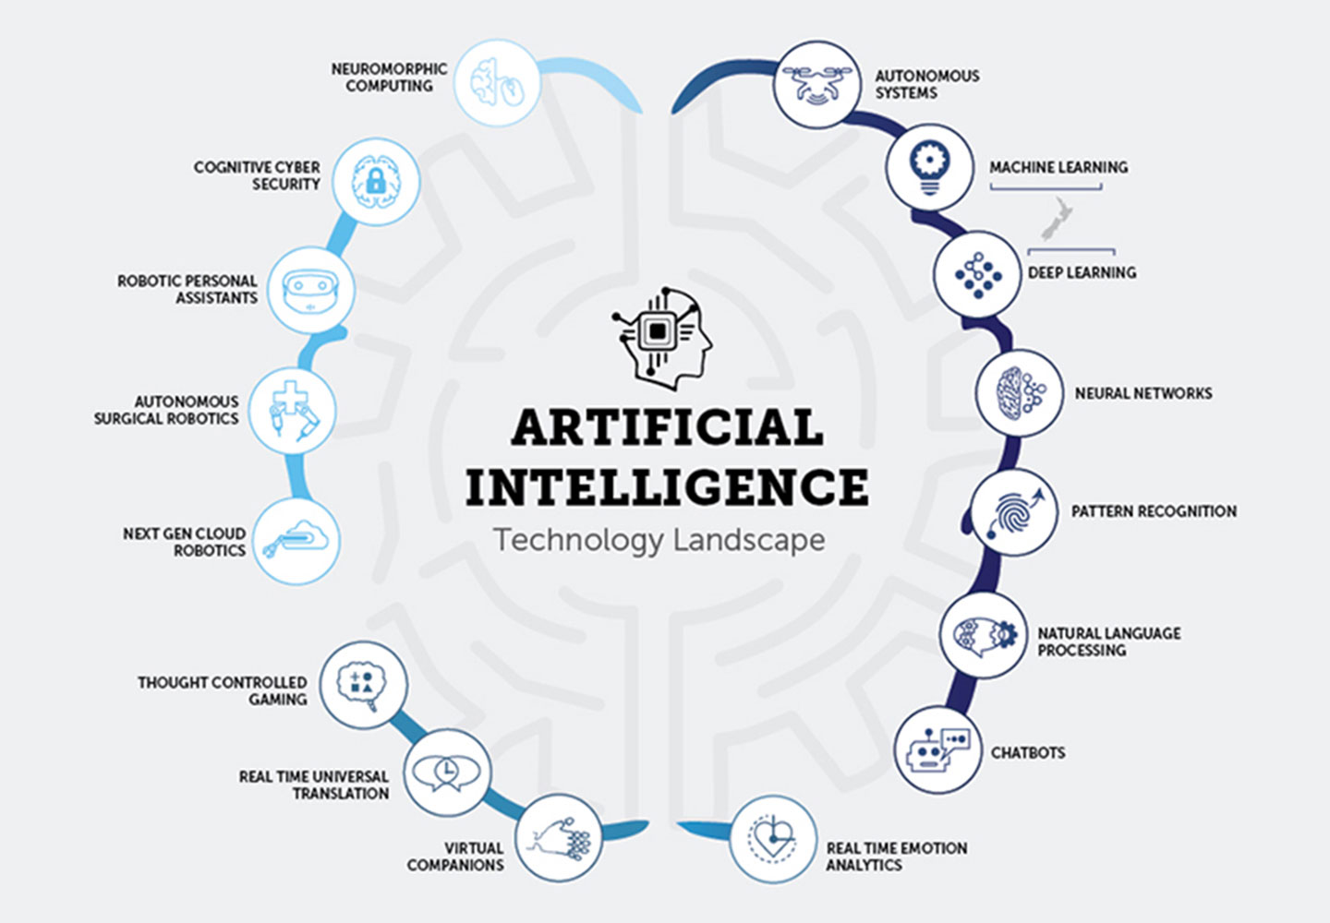
WHAT
IS
ARTIFICIAL
INTELLIGENCE ?

Slide 7
AI, ML, DL, RL and Big Data

Slide 8
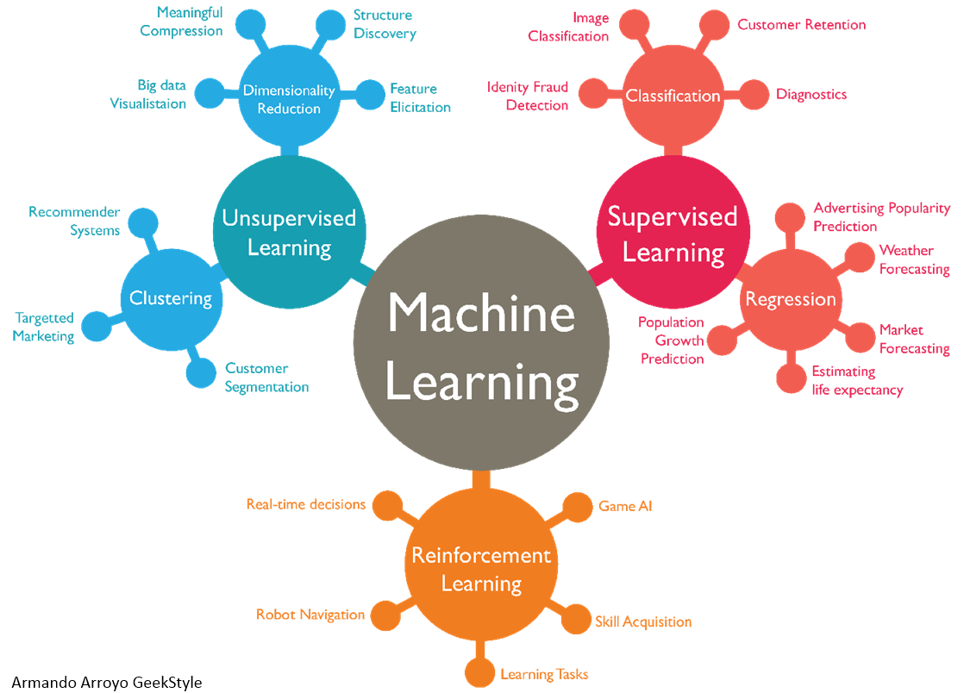





Slide 9
AI, ML, DL, RL and Big Data

Slide 10


Slide 11
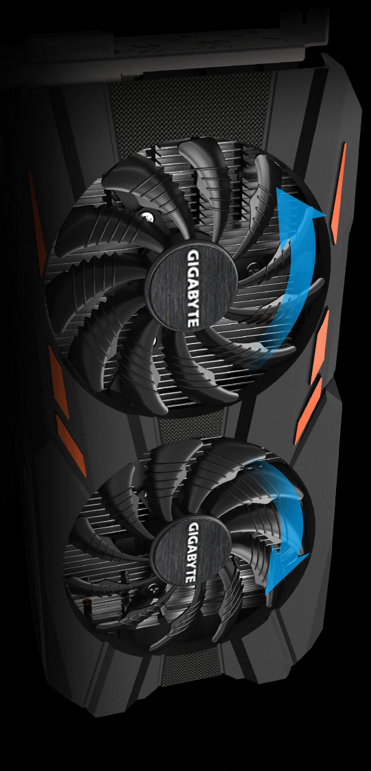

Slide 12
REINFORCEMENT LEARNING

Slide 13
89,526,124
Whoa! That’s a big number, aren’t you proud?

Slide 14

THANKS!
Any questions?

